Slide 1

Introduction to DevOps

Slide 2

Agenda
Software Delivery Process
Introduction to CI/CD

Slide 3
1
Software Delivery Process

Slide 4
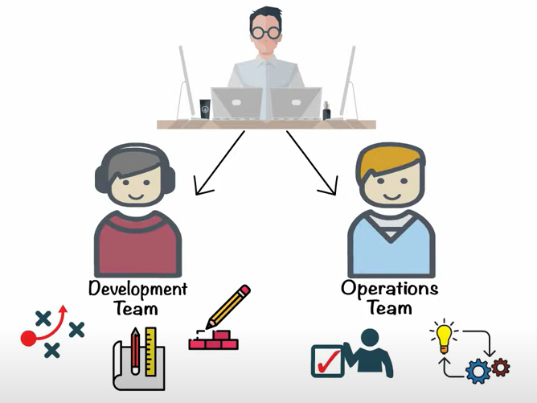

Project team

Slide 5
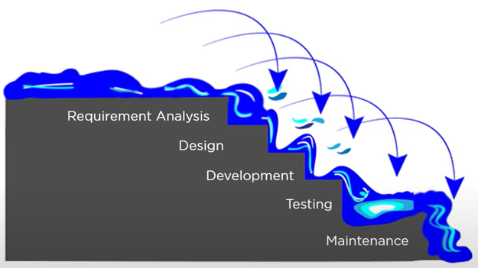
waterfall

Slide 6
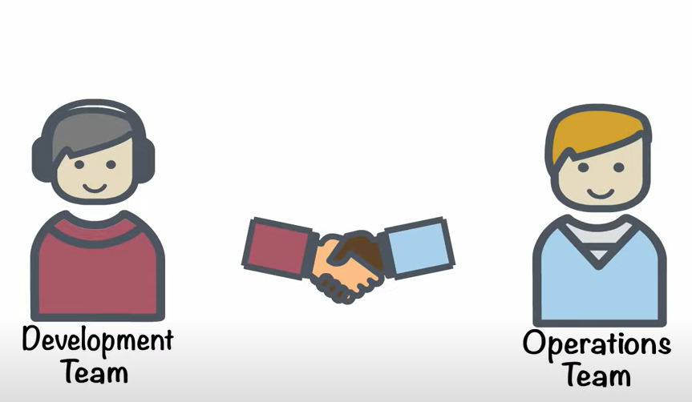
Work in colaboration

Slide 7
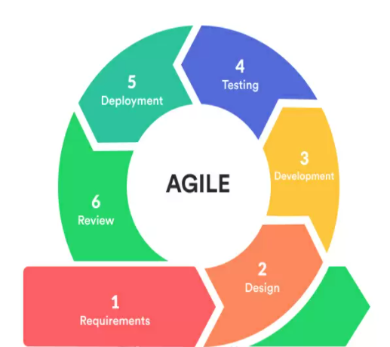
Agile Overview
Agile software development refers to a group of software development methodologies based on iterative development, where requirements and solutions evolve through collaboration between self-organizing cross-functional teams.
Agile methods attempt to maximize the delivery of value to the customer and minimize the risk of building products that do not – or no longer – meet market or customer needs.

Slide 8
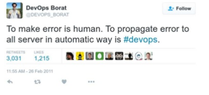
DevOps is a process not a tool.
DevOps requires tight cooperation between Dev and Ops teams
Different IT companies define DevOps in a different way:
Developer-friendly operations. IT activities are organized on a way which is more developer-friendly, ie. they are enabling developers to provision infrastructure themselves.
DevOps as one consolidated team of Developers and Operations staff. In this model, Developers take responsibilities of Ops staff and vice-versa.
What is DevOps?

Slide 9
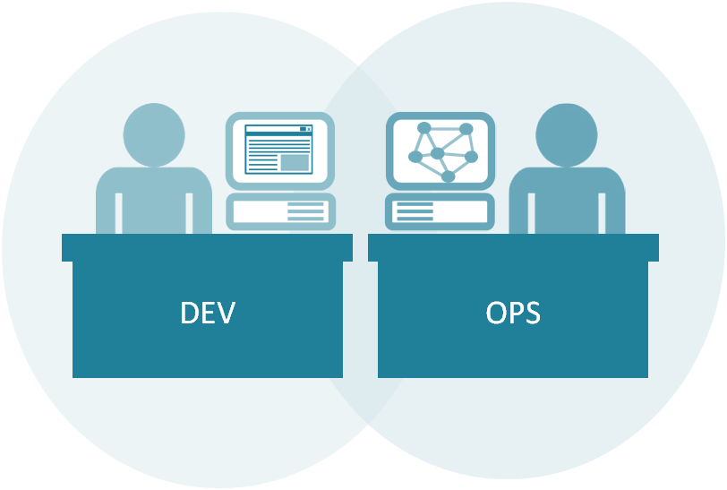
DevOps is all about bringing the latest software changes to end-users fast and frequently with high quality in mind.
The speed it brings boosts users’ satisfaction, beats competition and helps you save a great amount of time and money on fixing problems when they occur.
DevOps enables delivering software releases in an automated and continuous manner with a click of a button.
What is DevOps?

Slide 10
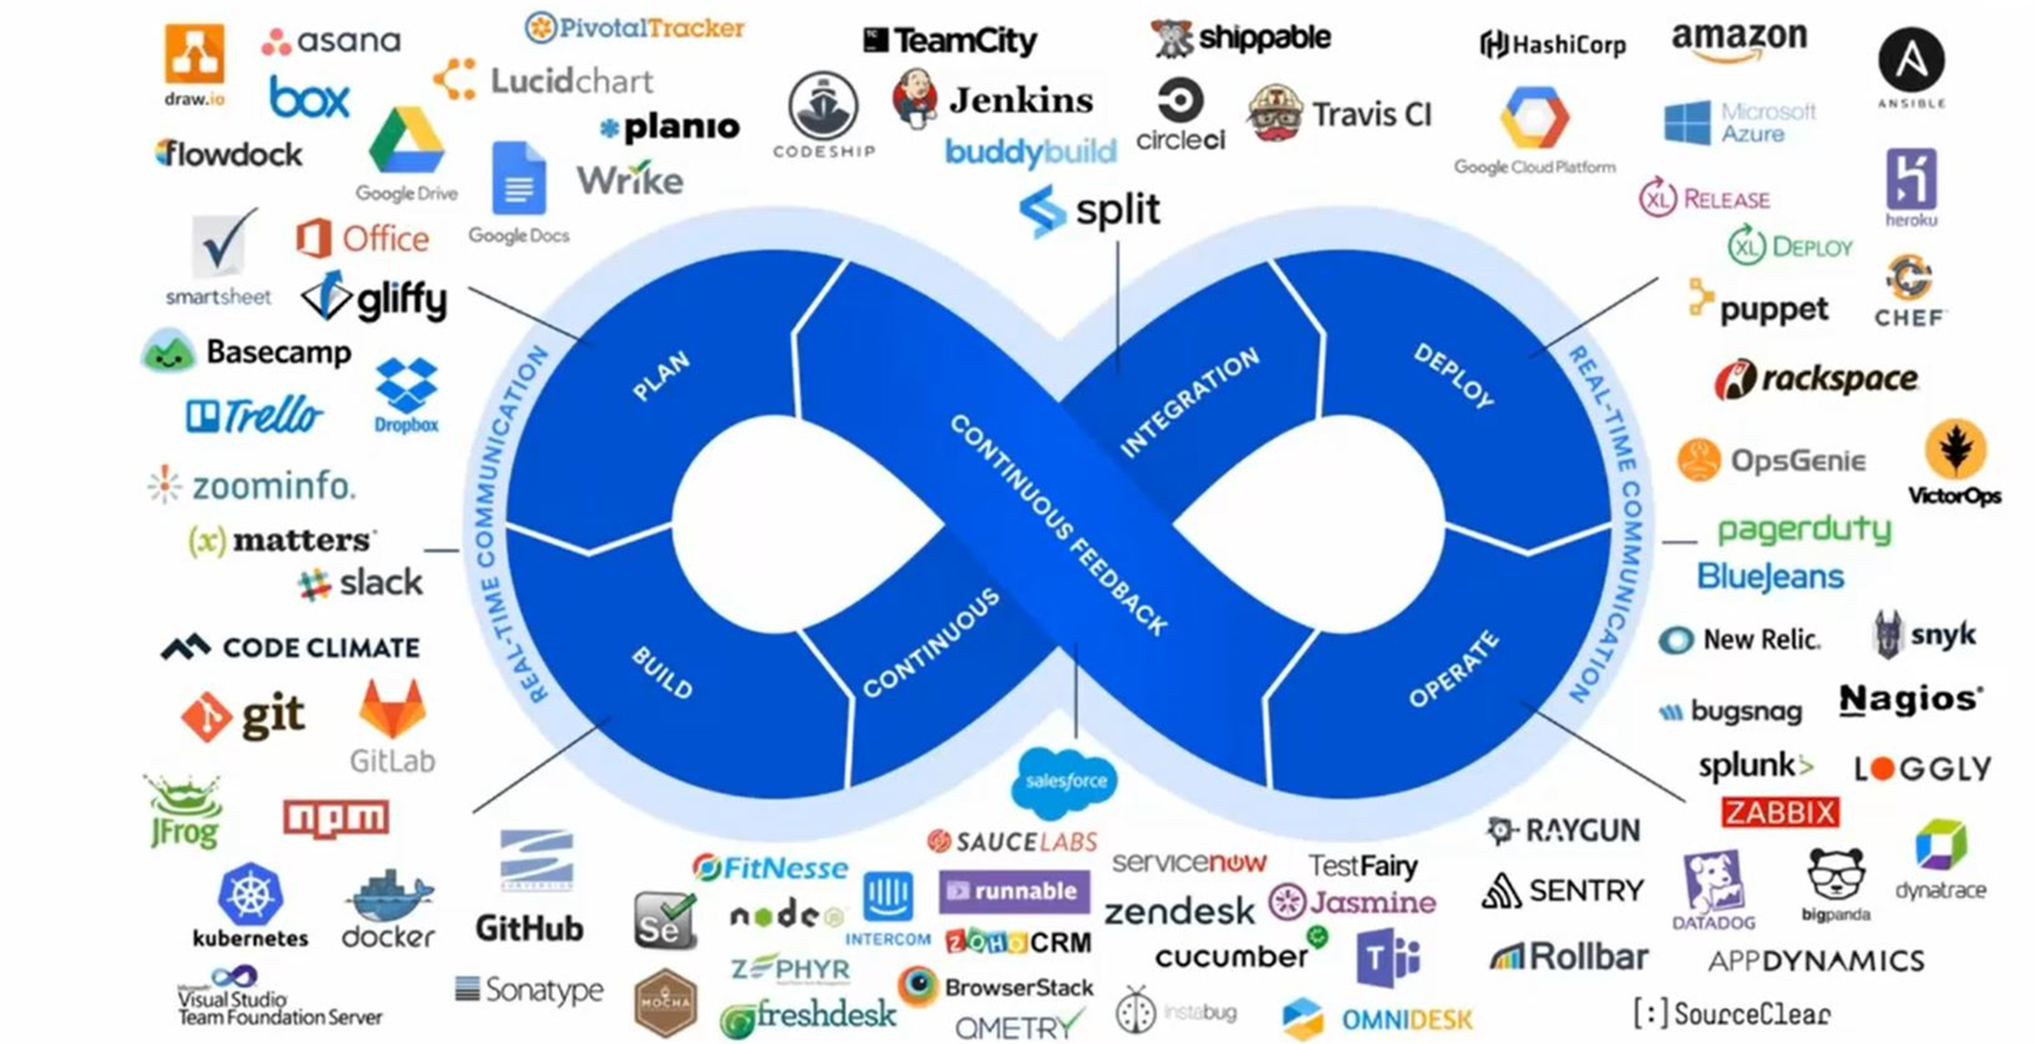
What is DevOps?

Slide 11
2
Introduction to CI/CD

Slide 12
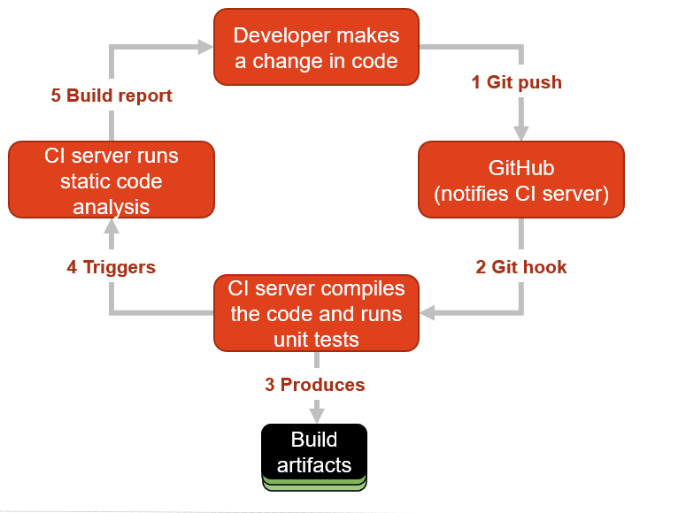

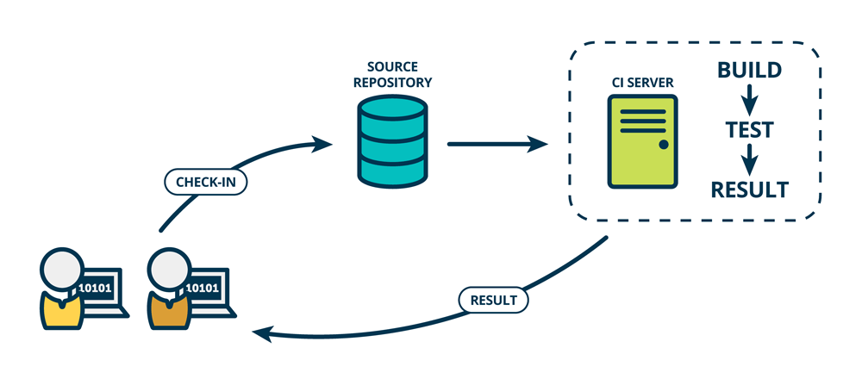
Continuous Integration
What is Continuous Integration?
Continuous integration refers to the build and unit testing stages of the software release process. Every revision that is committed triggers an automated build and test.

Slide 13




CI benefits:
Improve Developer Productivity
Find and Address Bugs Earlier
How to implement CI?
Keep everything under version control
Create automated builds
Get agreement from your team for the new way of working
Some tools:
Jenkins
Travis CI
Bamboo,
Team City
Continuous Integration
Continuous Integration

Slide 14
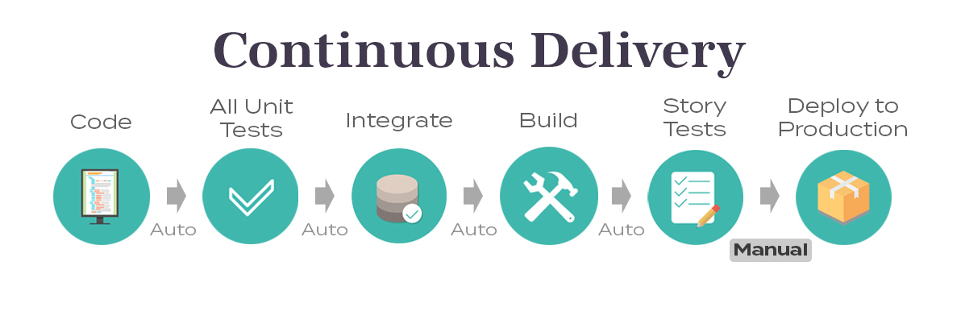
Continuous Delivery
What is Continuous Delivery?
With Continuous Delivery code changes are automatically built, tested, and prepared for a release to production
It expands upon Continuous Integration by deploying all code changes to a staging environment after build and tests are completed with success
When implemented properly, developers will always have a deployment-ready build artifact that has passed through a standardized test process

Slide 15
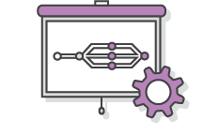



Automate the Software Release Process
Continuous delivery lets your team automatically build, test, and prepare code changes for release to production so that your software delivery is more efficient and rapid.
Improve Developer Productivity
These practices help your team be more productive by freeing developers from manual tasks and encouraging behaviors that help reduce the number of errors and bugs deployed to customers.
Find and Address Bugs Earlier
Your team can discover and address bugs earlier before they grow into larger problems later with more frequent and comprehensive testing. Continuous delivery lets you more easily perform additional types of tests on your code because the entire process has been automated.
Deliver Updates Faster
Continuous delivery helps your team deliver updates to customers faster and more frequently. When continuous delivery is implemented properly, you will always have a deployment-ready build artifact that has passed through a standardized test process.
Continuous Delivery
Continuous Delivery

Slide 16
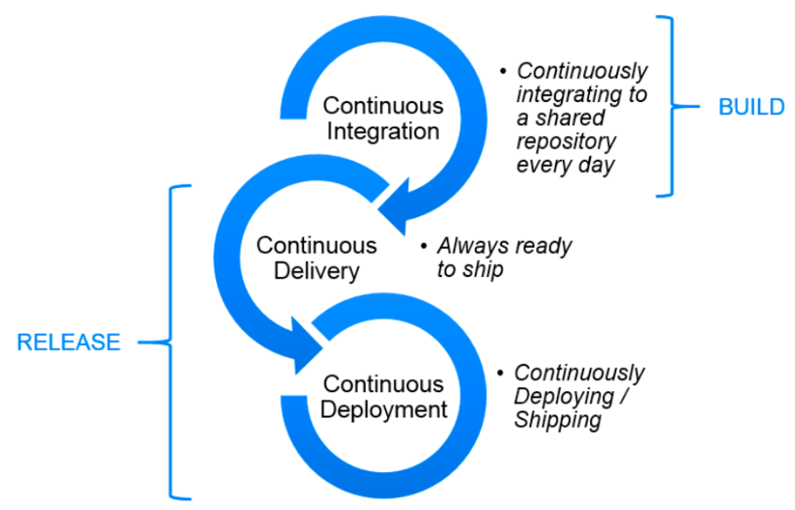
Old way / new way

Slide 17




Monitoring starts in development! The same tools that monitor the production environment can be employed in development to spot problems before they hit production.
Two kinds of monitoring are required for DevOps: server monitoring and application performance monitoring.
Some tools for the job: Nagios, Splunk, Datadog
Continuous Monitoring

Slide 18
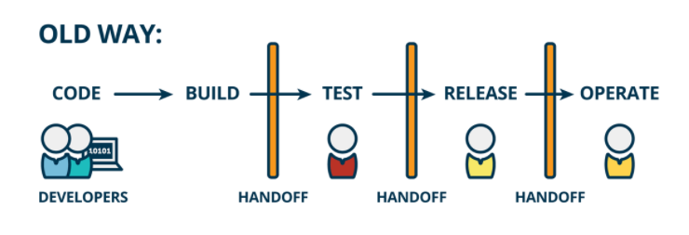
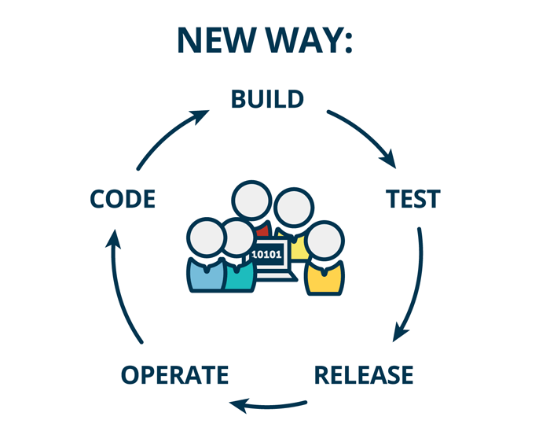
Old way / new way

Slide 19


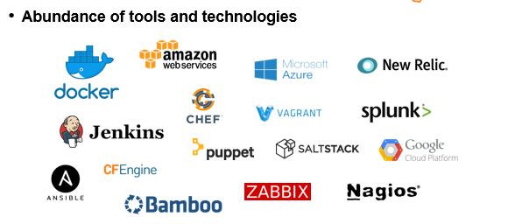
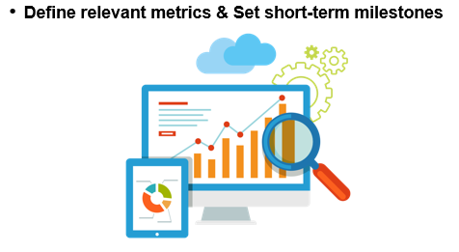

Application and End-User focus
Collaboration
Performance orientation
Development speed
Service orientation
Automation
Monitor everything
Core principles
Old way / new way

Slide 20
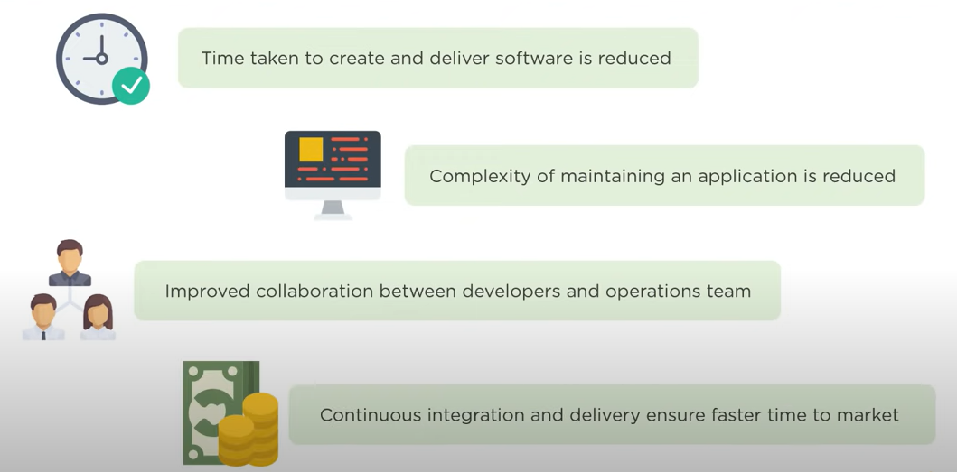
DevOps advantages

Slide 21
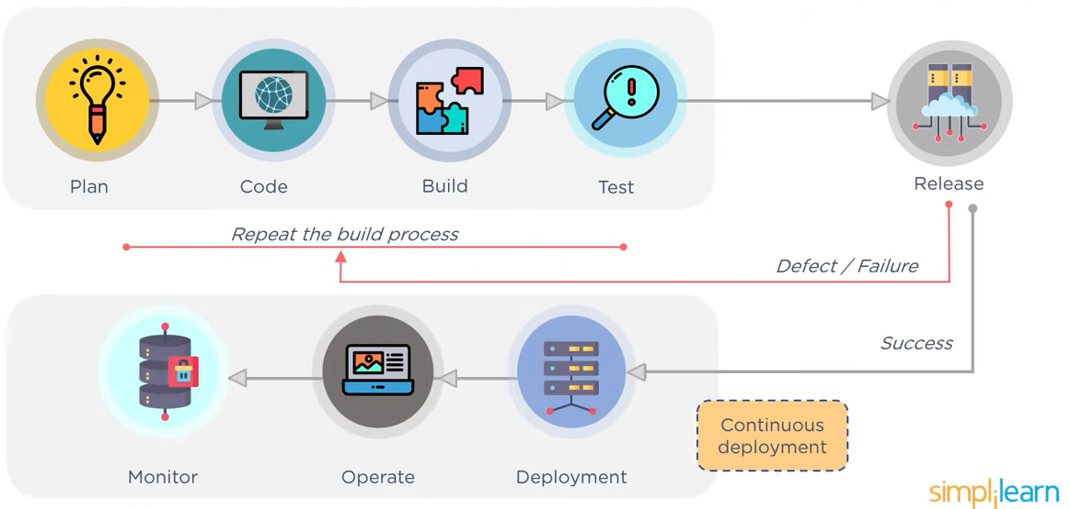
DevOps best way

